Slide 1


2011 Employer and Employee Survey
Key Findings
Notes:
Every 2 years the getDowntown Program conducts a survey of downtown Ann Arbor Employers and Employees to 1. Get a snapshot of the commuting habits of downtown Ann Arbor employees; 2. Gauge Employer and Employees attitudes, awareness and use of the getDowntown Program and of transportation options in general.
In 2011, the getDowntown Program worked with CJI Consulting to conduct a survey of downtown Ann Arbor employees and employers. For the most part, employers and employees participated in the survey by taking the survey online. A small handful of employees also took a paper version of the survey.
A total of 260 employers completed the Employer Survey. A total of 279 employees from 11 different downtown organizations complete the Employee Survey. This response rate was high enough to create a representative sample of Employers and Employees.

Slide 2


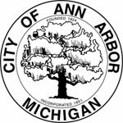
What is getDowntown?
+
=
+

Slide 3
Part 1: getDowntown Employer Survey
A total of 260 Employers completed the online Employer Survey.
The employers included:
  Authentic Art Tattoo Studio
  Arbormoon Software
  Olson Law Group
  Five Guys Burgers
  Mobiata
  Resonant Venture Partners
  Ragstock
  revive + replenish
  Chinese Acupuncture
  Dickinson Wright PLLC
  Google
  Lecturers Employee Organization LEO
  Clean Water Action
  Vault of Midnight
  State Theater
  Gratzi / Chop House
  Menlo Innovations
  Monahan's Seafood Market
  Gold Bond Cleaners
  Campus Inn
  Butzel Long
  Café Felix
  Hobbs + Black Associates
Top 3 Industry Categories:
37% Professional/Managerial/Technical
18% Retail
10% Food Related Service

Slide 4
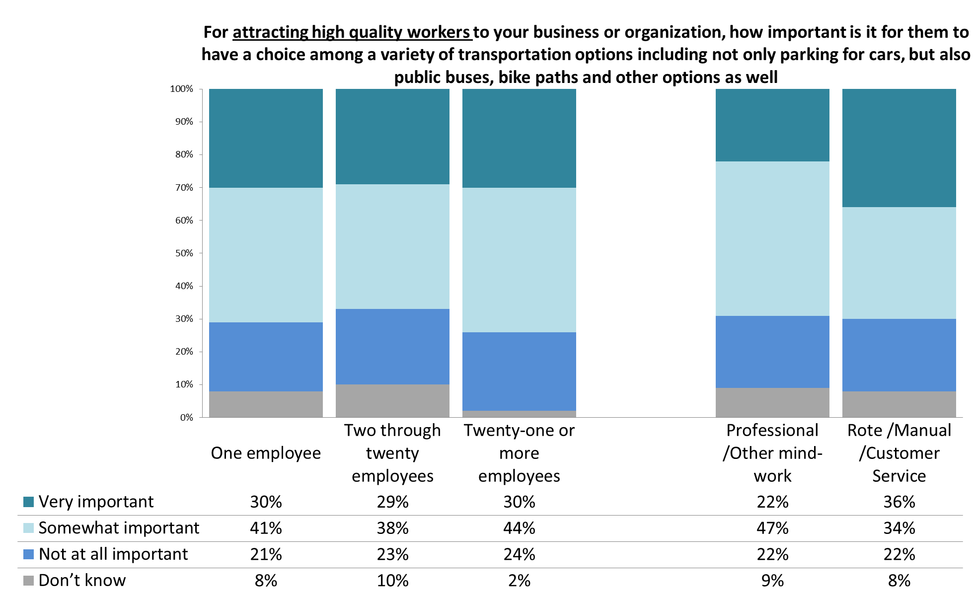
For Recruiting A Quality Workforce for Your Organization, How Important Are Transportation Options?

Slide 5
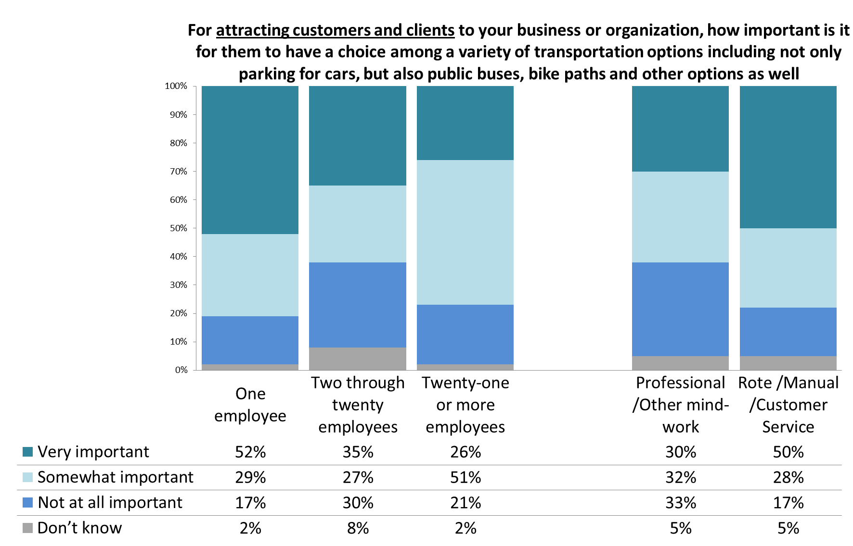
For Attracting Customers, How Important Are Transportation Options?

Slide 6
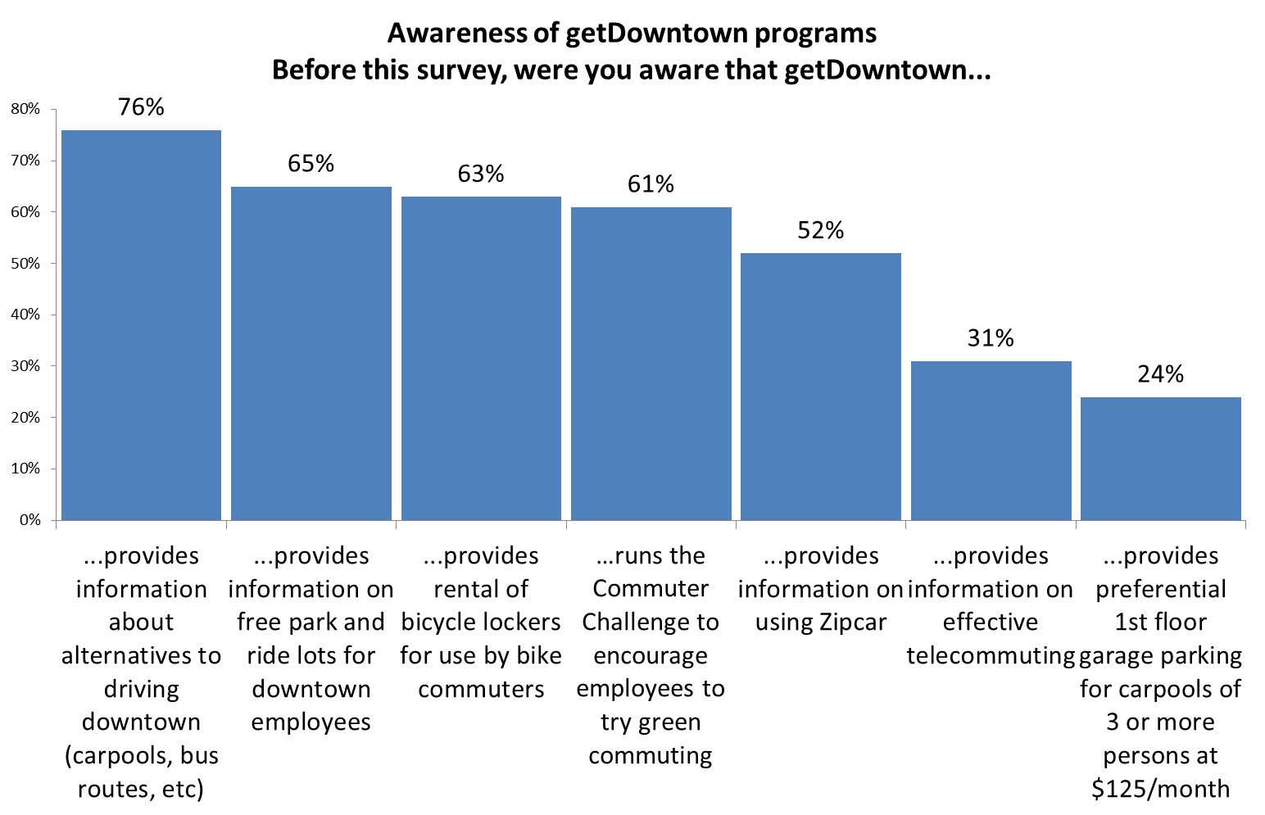
How Aware Are Employers of getDowntown Programs?

Slide 7
Part 2: The Employee Survey
A total of 279 employees from eleven employers responded online or on paper.
The employers included:
  Ann Arbor District Library
  AnnArbor.Com
  ApplEcon LLC
  Bank of Ann Arbor
  Conor O'Neills
  Digital Ops
  First United Methodist Church Ann Arbor
  NovoDynamics, Inc.
  People's Food Coop
  Seva Restaurant
  Zingerman's Deli

Slide 8
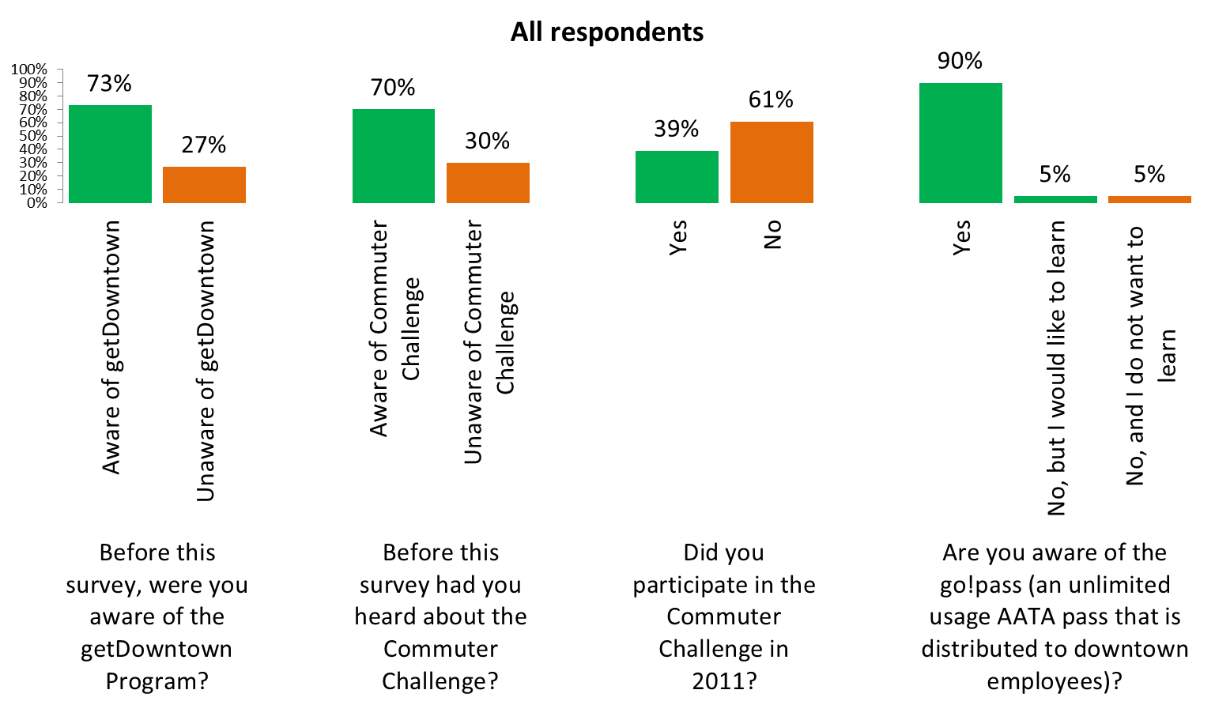
Awareness of getDowntown

Slide 9
How Employees Commute to Work
Mode to work | 2011 Survey | 2009 Survey | 2000 Census
Drive Alone | 57% | 61% | 65%
Public Transit | 18% | 15% | 8%
Walk | 13% | 14% | 17%
Rideshare | 3% | 6% | 7%
Bicycle | 6% | 2% | 2%
Other | 3% | 1% | 1%

Slide 10
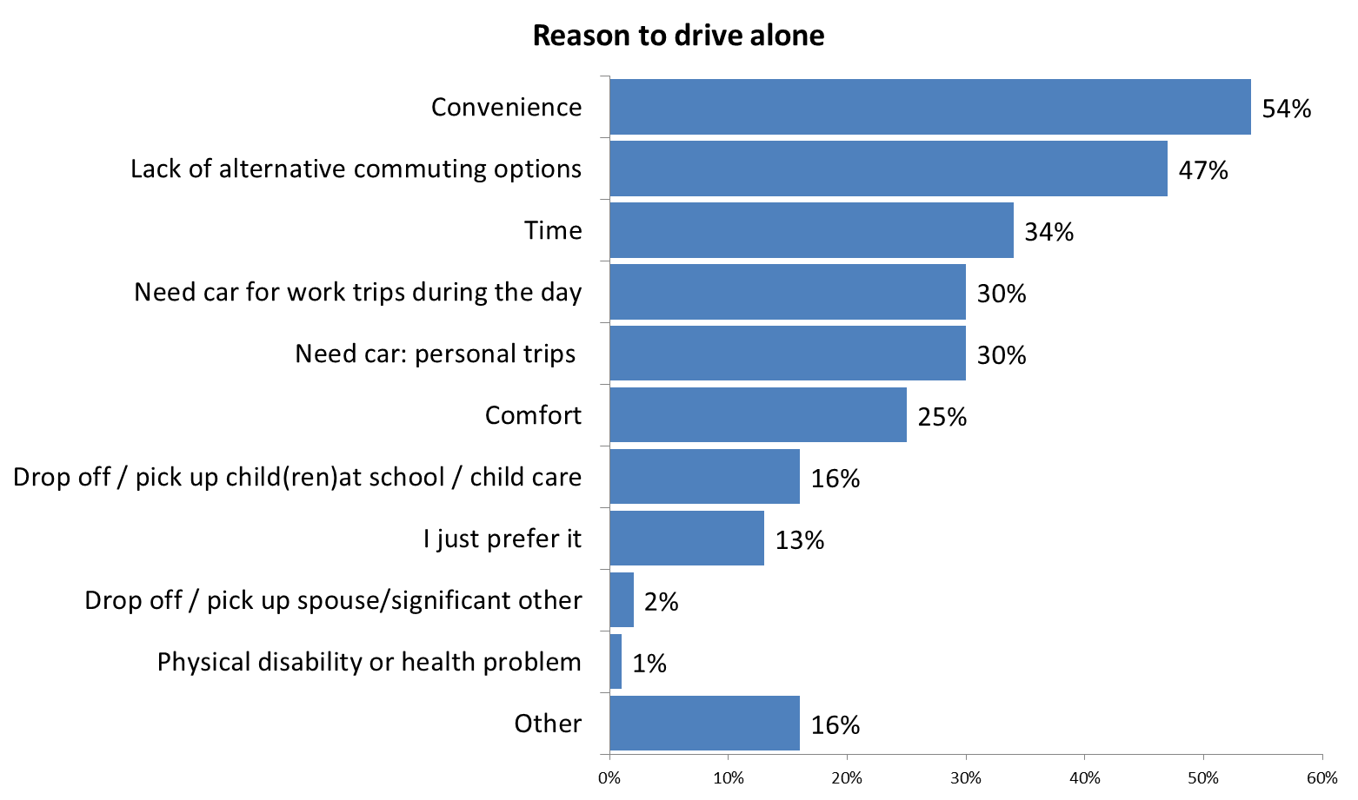
Why Do Employees Say They Drive Alone to Work?

Slide 11
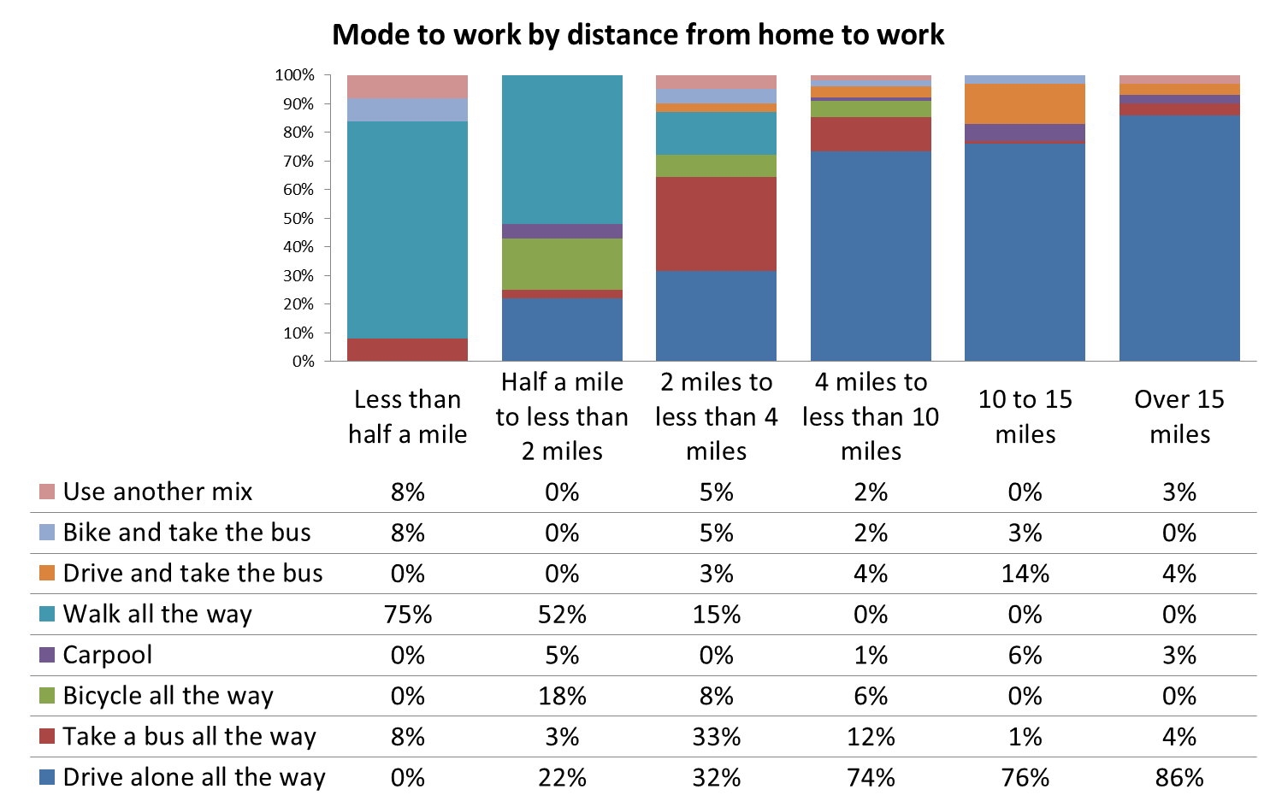
How Does Mode to Work Vary with Distance to Work?
Notes:
2.5 miles is average distance traveled by bus according to the Commuter Challenge data

Slide 12
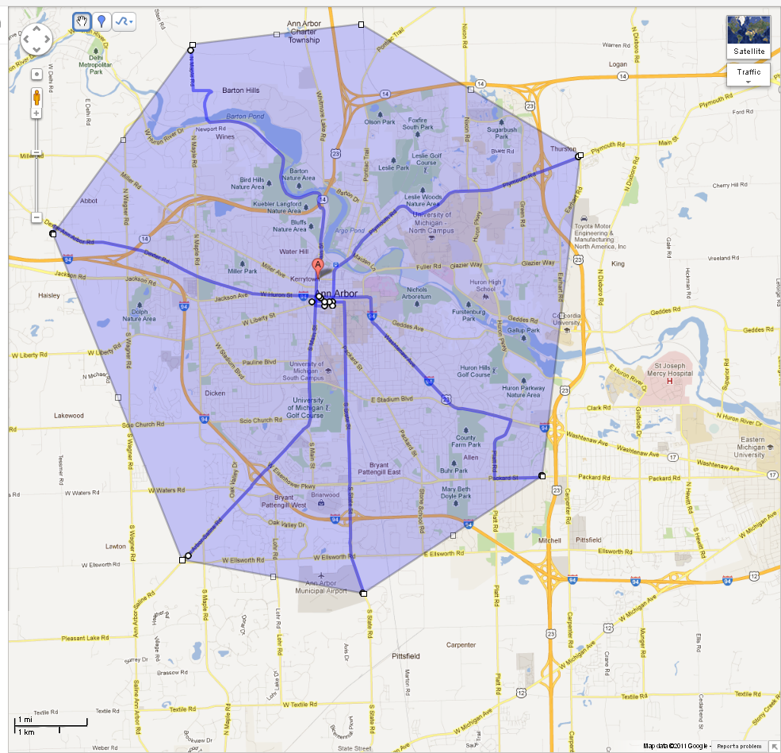
What Does 4 Miles Look Like?
Notes:
So what is 4 miles? That’s about the distance around the City of Ann Arbor

Slide 13
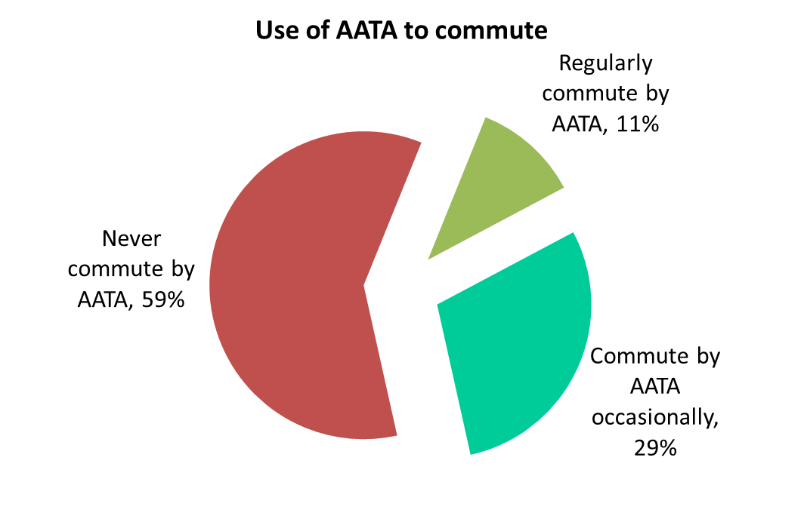
Commuting Via AATA
Notes:
Encourage more use by increasing service

Slide 14
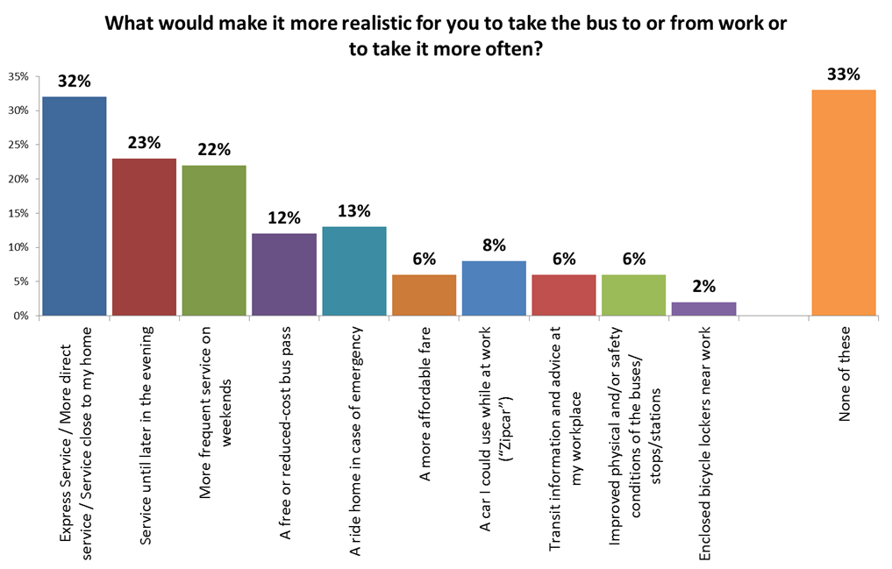
Encouraging More Use of Transit
Notes:
Advocacy for DDA

Slide 15
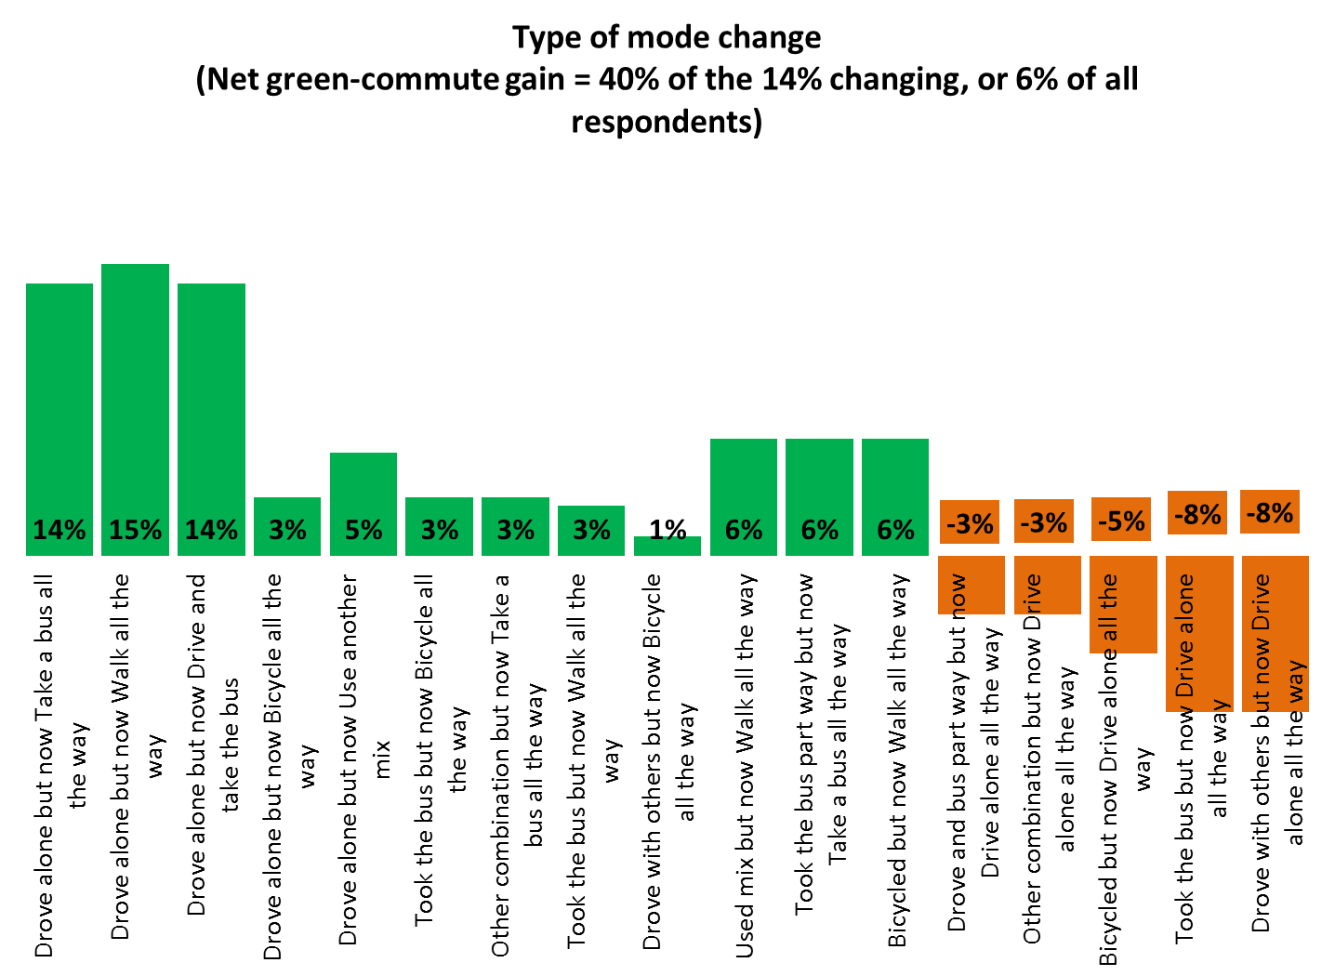
How Have Commuting Modes Changed?
Notes:
Looking at the top 3 Commuting Mode Changes, the top reasons for these changes were

Slide 16
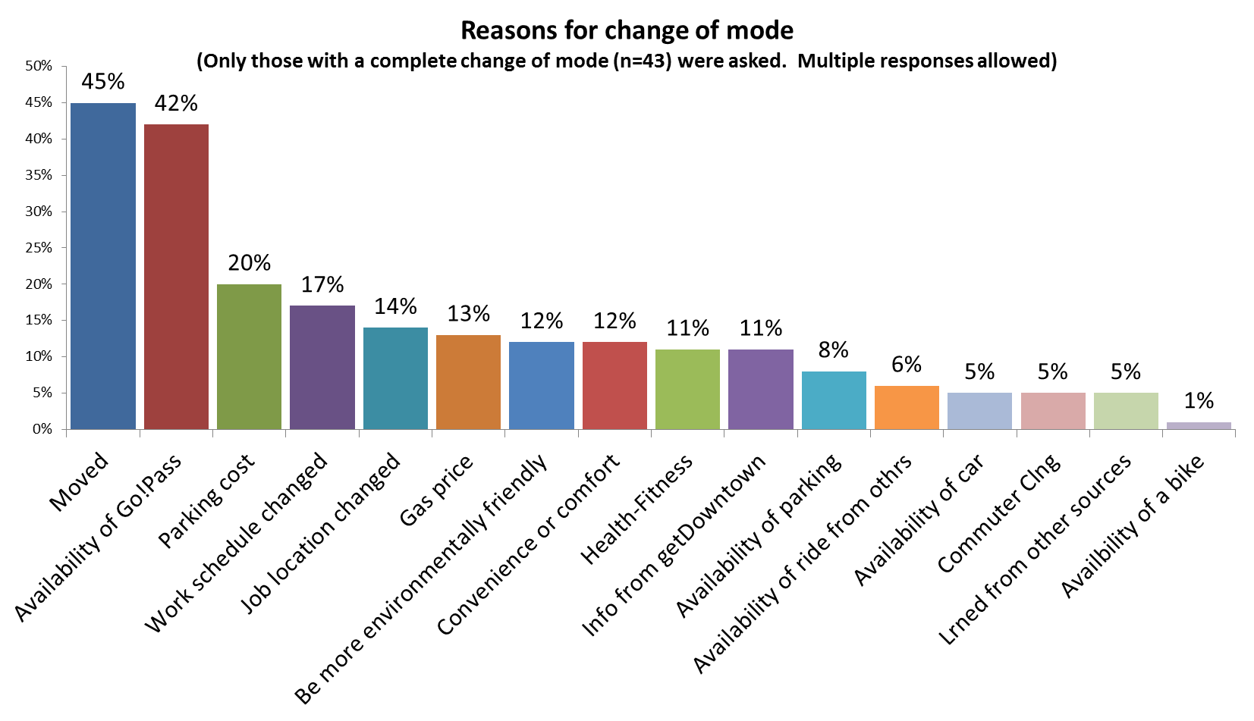
Why Do those Who Changed Modes Say they Changed?

Slide 17
Thank You!
Nancy Shore
getDowntown Program
518 E. Washington
Ann Arbor, MI 48104
nancy@getdowntown.org
734-214-0114

