Slide 1
Public Space: streets, plazas, parks
Three rationales for the Library Lane Plaza
1. Urban rationale – Downtowns need outdoor
living rooms that are
a.) spatially well defined, enclosed by buildings
on at least three sides (ideal width is 100 ft.)
b.) activated by programmed, spontaneous and
informal activities for diverse demographics
c.) with lots of entrances, windows, retail on
the edges, as well as “eyes” on the plaza

Slide 2
Public Space: streets, plazas, parks
Library Lane Plaza
2. Architectural rationale – a plaza is better
suited structurally for construction on top of
parking garage than a park, which needs deep
soil for trees and berms

Slide 3
Public Space: streets, plazas, parks
Library Lane Plaza
3. Environmental rationale – greener to have a
dense, complete downtown than suburban
sprawl (urban residents have smaller ecological
footprints per capita)

Slide 4
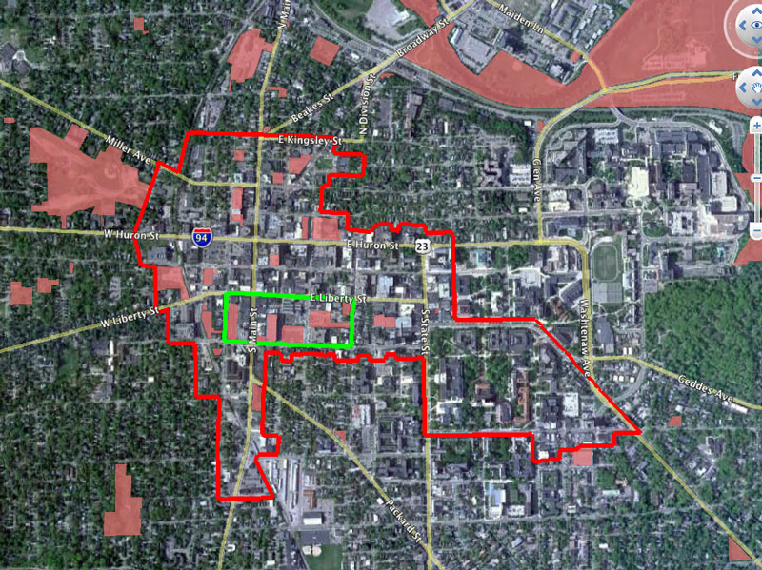

Slide 15
a pedestrian path from greenway to campus?

